Slide 1
ACPD Incidents 2005-2015 - Preliminary Analyses -
Madison Arnsbarger, Gizem Korkmaz, Vicki Lancaster, Aaron Schroeder and Stephanie Shipp
January 13, 2016

Slide 2

Biocomplexity Institute of Virginia Tech
The study of life and environment as a complex system
Understanding biology in the context of ecosystems and human-created systems
Transdisciplinary team science
“From molecules to policy”
2
Notes:
First, let me tell you about our lab.
Our Social and Decision Analytics Lab is a relatively new activity in the BCI which is 1 of 7 cross-disciplinary research institutes at VA Tech.
Our vision is to model massively interacting systems from molecules to policy to answer some of the most pressing challenges to human health, habitat, and well-being.
We are on the policy side of this ambitious information biology initiative and are therefore located in Arlington, VA to be close to policymakers at all levels.

Slide 3
Social and Decision Analytics Lab
The Social and Decision Analytics Laboratory brings together statisticians and social and behavioral scientists to embrace today’s data revolution, developing evidence-based research and quantitative methods to inform policy decision-making.
Science of ALL Data
Community Learning Data Driven Discovery
Education and Labor Force Analytics
Health and Well Being Analytics
Emergency Management Analytics
Industrial Innovation Analytics
Information Diffusion Analytics
Notes:
Our lab an intentional collection of statisticians and social scientists who have a common vision to study the social condition quantitatively at scale.
Our overarching research thrust is creating and developing the science of all data and Community Learning Data Driven Discovery Analytics.
We did not set out to do what we are doing today. We thought we would focus on topics related to megacities but, as we began to work with our local community, our focus shifted.
Our goal is to bring Data Science to our 3000 communities primarily small and medium sized and rural local governments.
An important aspect of our research is how information reaches people and affects their outlook and actions.

Slide 4
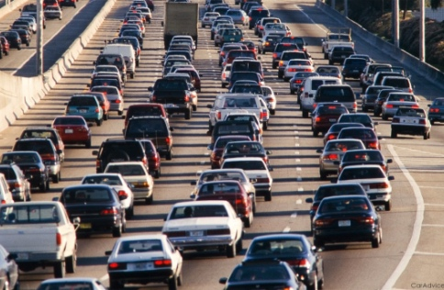

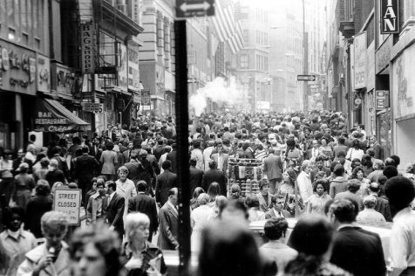
Social and behavioral data flows
Infrastructure
Environment
People
Condition
Operations
Resilience
Sustainability
Climate
Pollution
Noise
Flora/ Fauna
Relationships
Location
Economic Condition
Communication
Activities
Health
Notes:
Natural Data Flows in Our Communities
There are Natural flows of data that are collected in our community as we go through our daily paces - these include social service data such as requests for snow removal, applying for a permit, or making a 911 call.
These data characterize the rhythm of our community - there are data about our infrastructure, our environment, and people – where we live, learn, work, and play.
The Story of the Community is in these data.

Slide 5
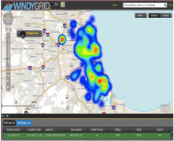


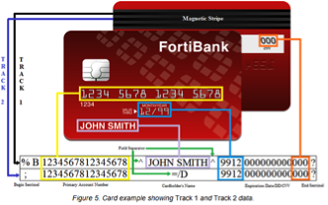




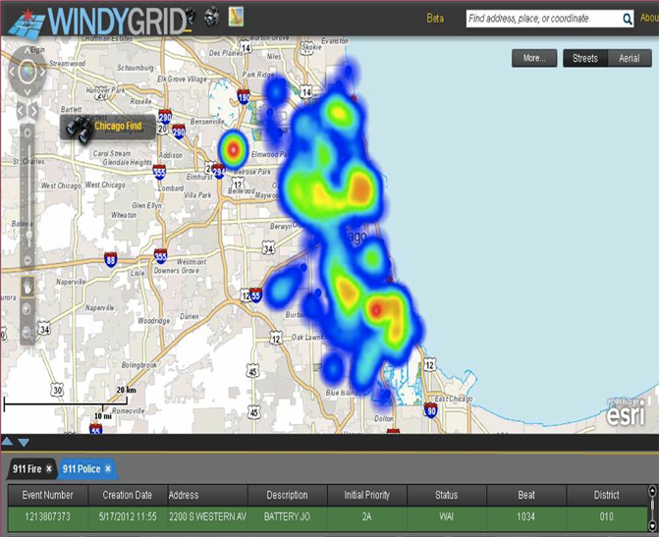


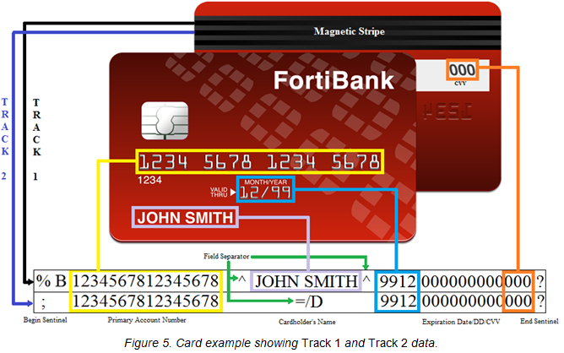

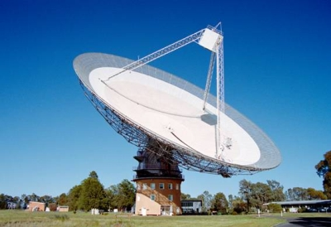
Bring the ALL data a revolution to communities
State, Federal, Local – Civilian and Defense Realizing the vision – data integration from molecules to policy
Designed Data
Administrative Data
Opportunity Data
Procedural Data
Designed Data Collections
Statistically designed data collections, such as surveys or experiments, and intentional observational collections.
Administrative Data
Data collected for the administration of an organization or a program.
Opportunity Data
Data generated on an ongoing basis as society moves through its daily paces.
Notes:
We are not talking about Big Data, we are talking about ALL data, which is not always big but always challenging.
We don’t worry about the size of the data, just what is useful to address a community’s questions
We put data into 4 buckets that helps us explain the data;
1. Statistically designed and intentional observational data collections from surveys and experiments, such as those using data from telescopes;
2. Administrative data – Data collected for the administration of an organization or program - these data have huge potential that is just so untapped.
We can repurpose these data and no new data collection is required.
3. Opportunity data – data from fitbits, internet, GPS, social media, sensors – where a lot of the hype of Big Data rests;
4. Procedural data - how to processes and policies shape our lives – this is especially important for our research in examining military communities.

Slide 6
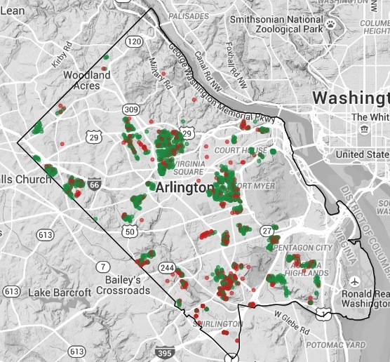
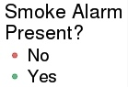
Arlington Operation FireSafe
Goal: to increase the number of residences in Arlington with smoke alarms
Build a predictive model to identify homes most in need of an alarm
Data Sources:
Operation FireSafe - Arlington County Fire Department visited 1733 homes, 32% did not have an alarm
Housing data - house value, size, age, number of bedrooms, and tenure for 60,343 housing units in Arlington County
ACS 2014 – demographic (age, sex, race) and socioeconomic variables (income, poverty, education, SNAP, household composition) at the block group
Notes:
The goal for Operation Firesafe is to increase the number of residences in Arlington with smoke alarms
Arlington County Fire Department visited 1733 homes, 32% did not have fire alarm. Fortunately for us, they collected data about this!
We mapped the Operation Firesafe data with Housing data such as house value, size, age, number of bedrooms, and ownership, for 60,343 housing units in Arlington County
Added in demographic data from the Federal American Community Survey.
Note – use of three types of data flows from local to federal.

Slide 7
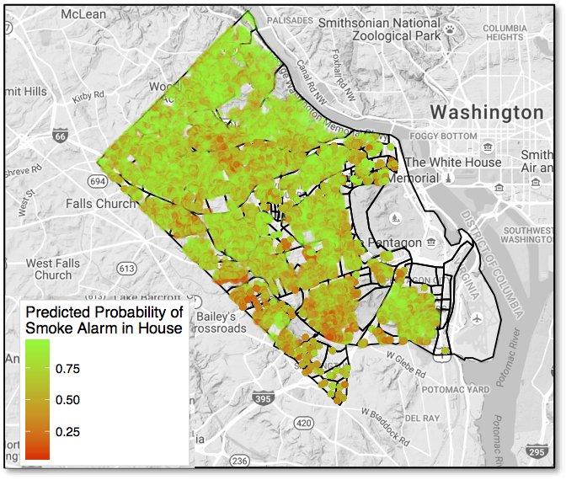
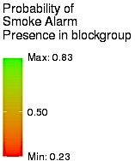
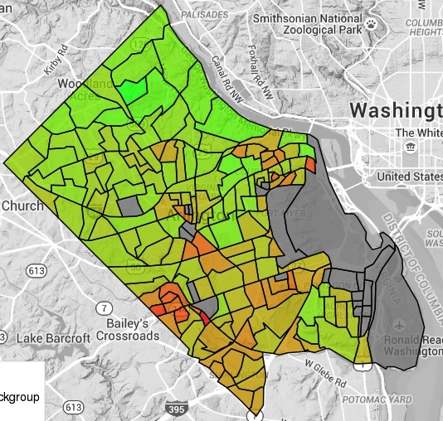
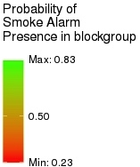
Probability of Having a Smoke Alarm
Bayesian logistic regression model with
conditionally autoregressive spatial effects
Census Block Level Predictions
Housing Unit Level Predictions
Notes:
Using a Bayesian logistic regression model to estimate the probability that a housing unit has a smoke alarm.
The results show that the Fire Dept. should focus on the southwest (bottom left hand corner) of Arlington.
This is an example of an issue that required mapping multiple sources of different kinds of data to inform a topic.

Slide 8












Diverse Sponsors – Diverse Communities
Local / State Government
Arlington County
Virginia Department of Emergency Management
Federal Statistical Agencies
Housing and Urban Development
National Science Foundation
National Center for Science and Engineering Statistics
U.S. Census Bureau
Department of Defense
U.S. Army Research Institute
Defense Manpower Data Center
Defense Advanced Research Project Agency
Industry
MITRE Corporation
Proctor & Gamble
Foundations
Robert Wood Johnson
Laura and John Arnold
Notes:
We work with a diverse set of sponsors and a diverse set of communities from a large Fortune 100 company to the US Army to the Census Bureau to local communities.
As we address more and more issues through the data, the science of data science is beginning to take form.
We have developed a data model that providers a disciplined approach to working with many disparate sources of data in our analysis.
We have also begun to automate some of the steps in this process.

Slide 9
SDAL Data Architecture
Data Infrastructure, Methods of Access
& File Transfer
Notes:
Thank organizers.
I am very excited to discuss a new initiative that we are developing and implementing at Virginia Tech to bring Data Driven Governance to our local governments and communities

Slide 10
Secure Data Access
VT VPN (Off-Campus Users Need Additional VPN Account)
Campus User
(Web Interface or Remote Desktop to Analysis Servers)
SDAL Server Host
BI Computing Center
Secure Multi-Hop Tunnel
Authentication
Server
(LDAP)
Port Mapping
Local 8787 -> Server 8787
RStudio
Server
(R)
(20 Cores)
SparkR
Server
(Apache Spark)
(38 Cores)
(Testing)
Microsoft R
Server
(Revolution R)
(38 Cores)
Jupyterhub
Server/IPython Notebooks
(Python)
(20 Cores)
Backup
Internal IPs
File
Server
(Encrypted Logical Volume per project)
Database
Server
(PostgreSQL)
(4 Cores)
Presentation
Server
(Shiny)
(2 Cores)

Slide 11
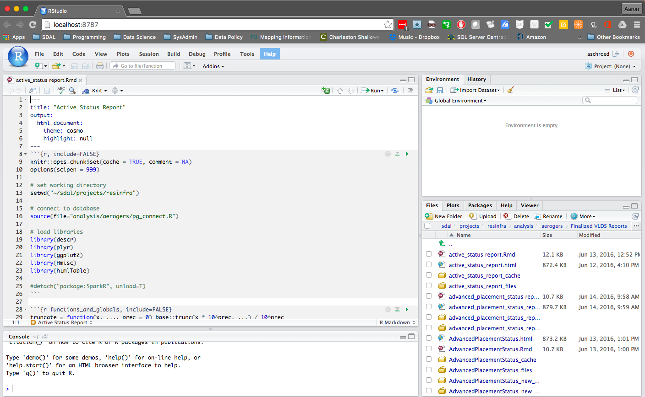
RStudio Server
User accesses local machine only
User works with files on file server – nothing downloaded locally

Slide 12
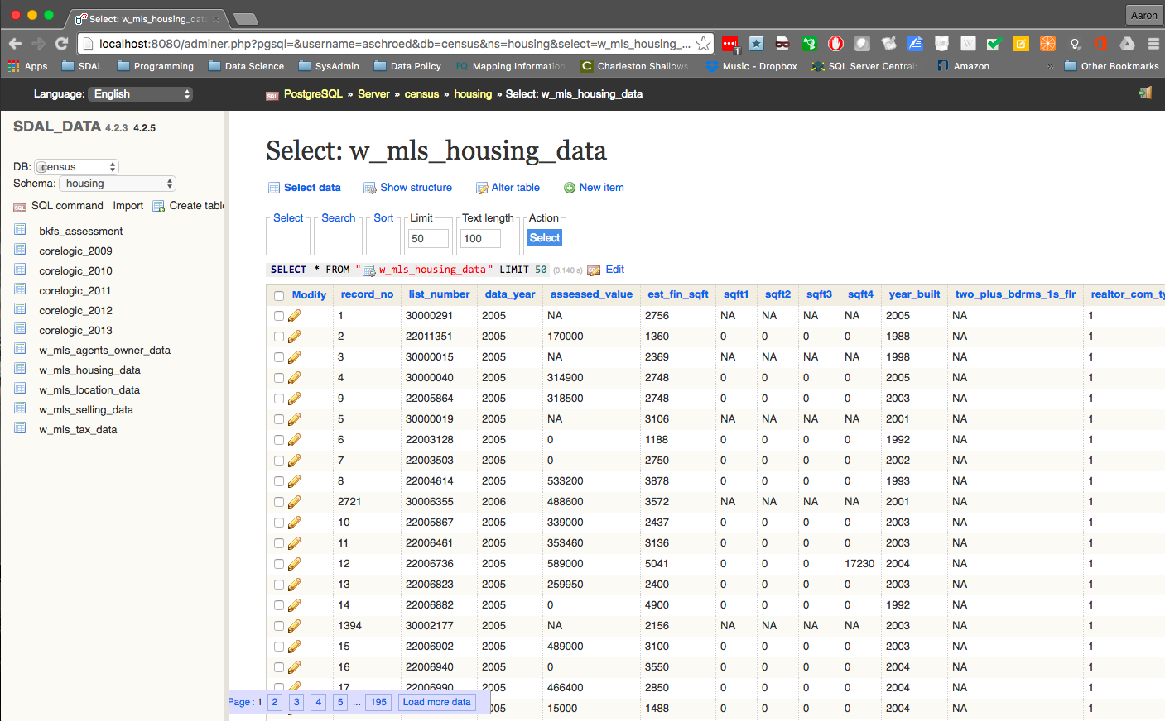
PostgreSQL Server (via Adminer)
User accesses local machine only

Slide 13
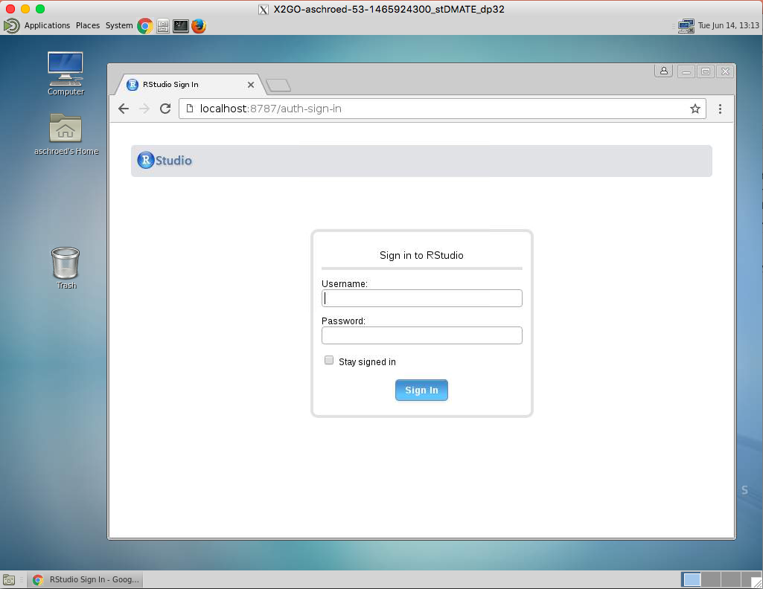
Remote Desktop to RStudio Server (via x2go)

Slide 14
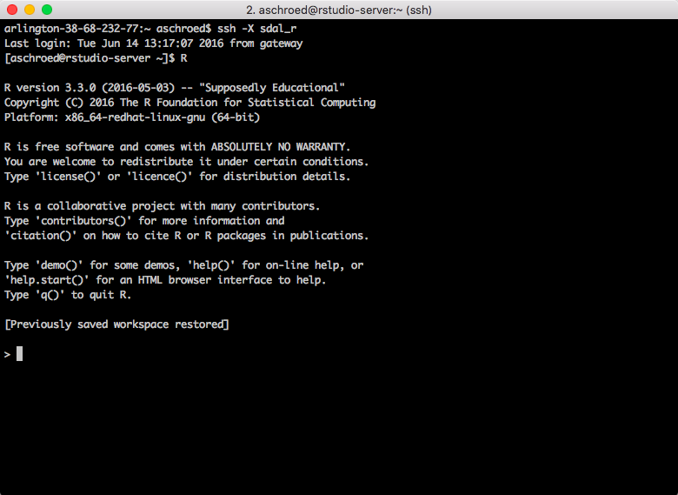
SSH –X Command Line Access

Slide 15
File Transfer
RSYNC
SCP
SSHFS local mount of remote drive
SFTP (ACPD File Transfer)

Slide 16
SDAL RESEARCH MODEL
Notes:
Thank organizers.
I am very excited to discuss a new initiative that we are developing and implementing at Virginia Tech to bring Data Driven Governance to our local governments and communities

Slide 17
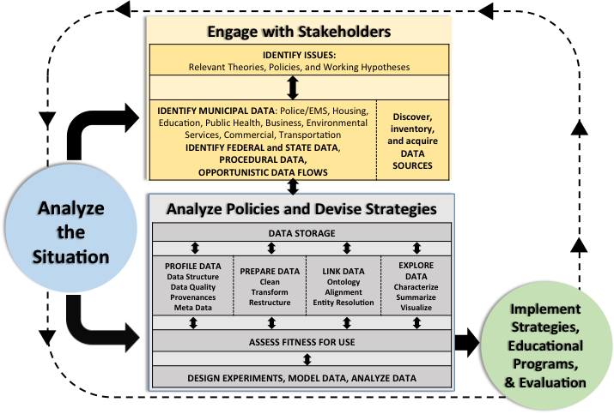
DATA PROCESS

Slide 18
Data Structure
Seven data tables:
Two Calls For Service (cfs) tables
Five Master Incident (inmast) tables
Years: 2005 – 2015
Translation Tables
(250,290)
(130,573)

Slide 19
Data Structure
(147,811)
(78,601)
(74,746)

Slide 20
Profiling: Data Quality
Determination of quality of data and utility to project at hand
Data Quality
Data Structure
Metadata and Provenance
Issues are discovered but not fixed, fix depends on research need
Data Quality Measures – Typology emerged
Completeness: characterization is application specific
Value validity: proper values
Consistency: logical agreement between record fields in one or more sources
E.g., locally derived information has no master list/file like student records
Uniqueness/heterogeneity :
Not generally associated with data quality but for research variety and richness of data values is of paramount importance
Duplication: degree of replicated observational units

Slide 21
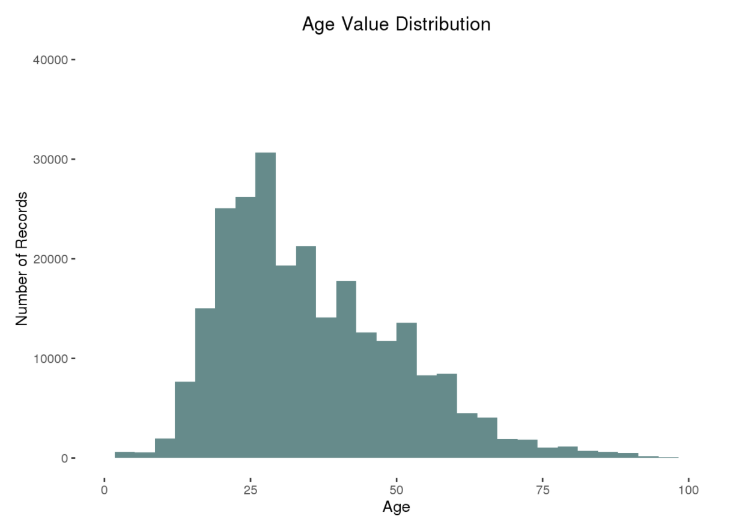
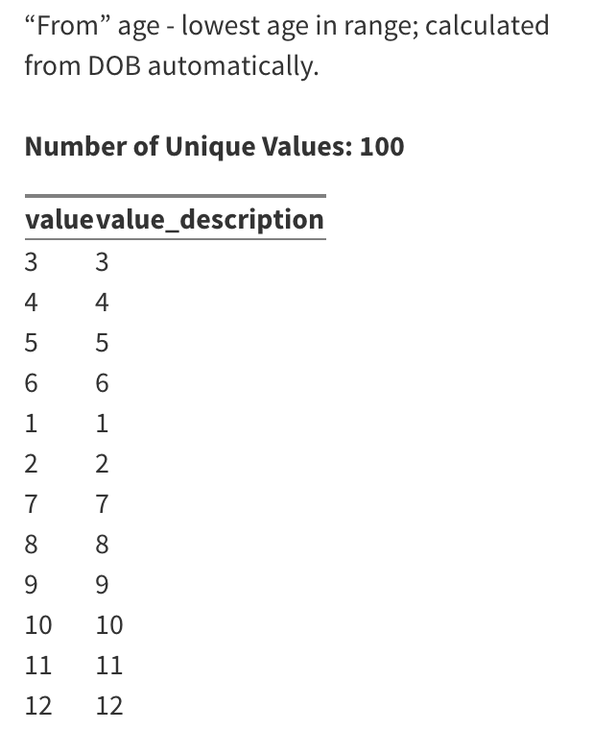
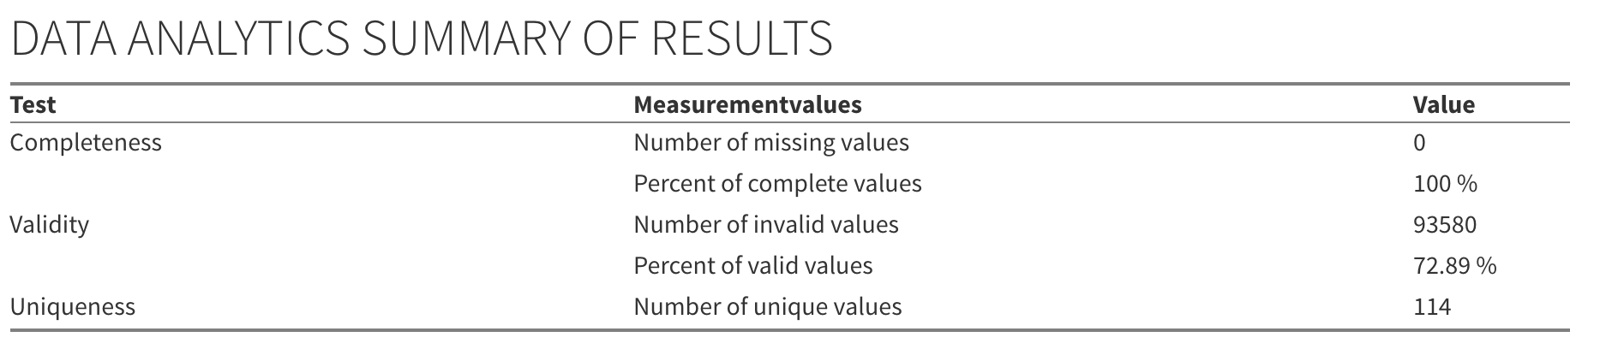
Profiling: Data Quality
Variable: Age
Definition:

Slide 22
Data Challenges
Date/Time Variables
Contain quotation marks and “AM/PM”
01/01/2005" "12:00:29 AM → 2005-01-01 00:00:29
Age Variable
Impossible ages:
202, 305, 405, 509, 600, 602 all exist in the dataset
Age 0 recorded for 93,556 rows
Some could be legitimate (i.e., victims under the age of 1?)
Map Coordinates
Format varies between and within tables
Five coordinate formats in the data
longlat, lat/long, long/lat, xy(stateplane), yx(stateplane)
Stateplane:
(11890321, 06994400) → (-77.0961, 38.88664)
Longlat:
-77.04041338.874868 → (-77.040413, 38.874868)
Long/Lat:
-77.084561/38.863888 → (-77.084561, 38.863888)
Notes:
12,206 suspects’ ages = 0, so it's not just a fluke (i.e. victims under the age of 1)
For explorat
str_replace(string = cfs.table$Received_Date_Time, pattern = "/", replacement = "-")
as.POSIXct(strptime(cfs.table$Received_Date_Time,
format = "%m-%d-%Y %I:%M:%OS %p"))
ory analysis, I’ve just been filtering data to exclude ages =0 and >100, but we should remove those rows before continuing
Need to search cfs-dispatched, for all 5 types, convert them separately, then reassign them to correct Call_No
Still working on converting within data tables
Converted lat/longs in Police Beat shapefile, so we’re able to map Beat now

Slide 23
Data Exploration:
What are trends in total incidents, by hour of day, day of week, by month?
Notes:
Thank organizers.
I am very excited to discuss a new initiative that we are developing and implementing at Virginia Tech to bring Data Driven Governance to our local governments and communities

Slide 24
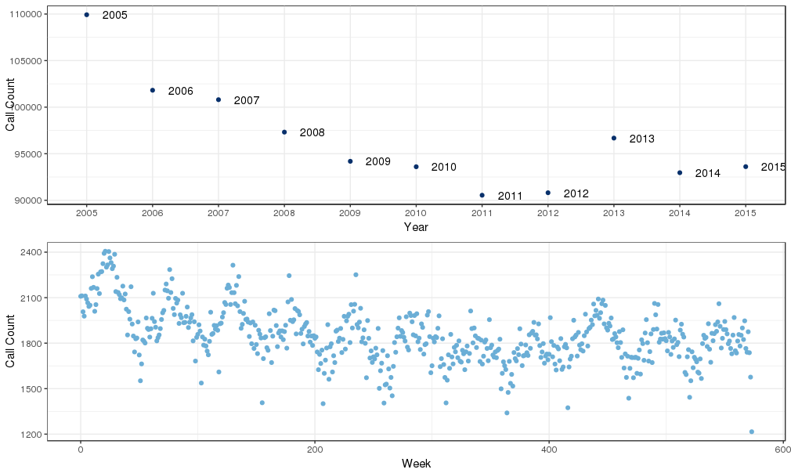
Total Call Counts (cfs) by Week and by Year

Slide 25
Top Calls across Years
Original Call | Number of calls (2005-2015) | Number of calls (2005) | Number of calls (2010) | Number of calls (2015)
T – Traffic Stop | 210,560 | 15,877 | 18,201 | 19,840
911 – Suspicious Circumstances | 65,883 | 5,413 | 7,030 | 5,070
PARK – Parking Complaint | 59,391 | 5,676 | 5,048 | 6,003
PDO – Accident Property Damage | 58,260 | 6,012 | 4,964 | 5,514
BEAL – Burglary, Alarm | 45,504 | 5,162 | 4,072 | 3,437
TRAF – Traffic Complaints | 44,805 | 5,816 | 4,178 | 3,412
LOUD – Loud Music or Party | 33,893 | 3,253 | 3,095 | 2,746
LARC – Larceny, Late | 26,522 | 3,099 | 2,359 | 1,912
DOME – Domestic Dispute | 24,379 | 2,293 | 2,396 | 2,219
SUSP – Suspicious Persons | 23,044 | 2,733 | 1,877 | 1,886
Total | 1,062,245 | 109,924 | 93,600 | 93,611
Notes:
COW - CHECK ON WELFARE
FRAUD
Boot
AWI – ACCIDENT w Injury
SHOP
SS – Subject Stop
ADMIN – Admin services
TRES

Slide 26
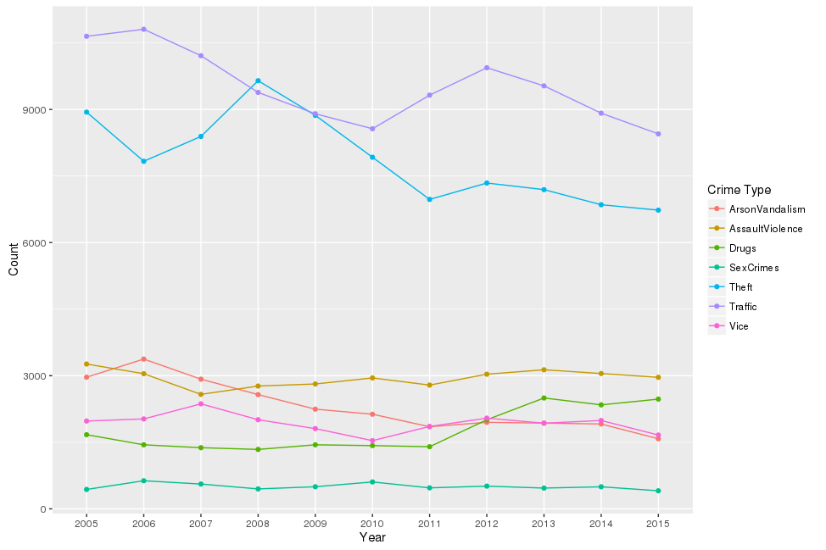
Call Types over Years
Notes:
COW - CHECK ON WELFARE
FRAUD
Boot
AWI – ACCIDENT w Injury
SHOP
SS – Subject Stop
ADMIN – Admin services
TRES

Slide 27
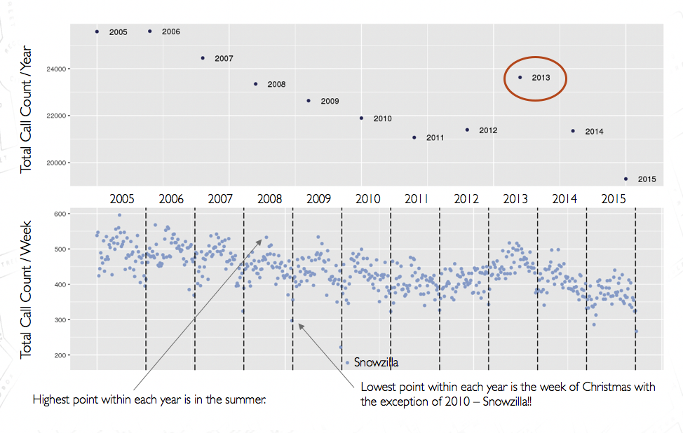
Total Incident Counts (inmast) by Week and by Year

Slide 28
Top Incidents (inmast) across Years
Incident Type | Number of incidents (2005-2015) | Number of incidents (2005) | Number of incidents (2010) | Number of incidents (2015)
98xx – Suspicious person-auto/Warrant/False alarms/ Misc. Officer/Domestics | 65,388 | 5,570 | 6,443 | 5,578
23xx – Larceny | 30,587 | 3,595 | 2,736 | 2,001
94xx – Motor vehicle incident | 29,751 | 3,035 | 2,444 | 2,550
92xx – Parking violation | 19,399 | 2,003 | 1,674 | 1,137
13xx – Assault | 11,551 | 1,334 | 1,025 | 950
29xx – Vandalism | 10,016 | 1,361 | 771 | 438
41xx - Drunk/Liquor/Detox/ABC | 9,448 | 1,017 | 768 | 696
97xx - Suicide/attempted suicide/find body/sick/mental | 7,704 | 503 | 606 | 893
35xx - Narcotics | 7,520 | 779 | 568 | 867
93xx - Lost person/property/animal | 6,687 | 719 | 619 | 551
Total incidents (all types) | 250,268 | 25,587 | 21,897 | 19,307

Slide 29
Original Call – Incident Mapping (2005-2015)
Original Call | Incident Type | Volume | Total
T - Traffic Stop | 9899 - Misc. Officer | 45,520 | 57,242
 | 5404 - DUI Liq. | 4,222
 | 9154 - Driving under Susp. | 1,582
 | 3562 - Narcotic Marijuana Possessing | 1,522
PDO - Accident | 9420 - Property Damage Motor Veh. | 13,013 | 15,175
 | 9410 - Personal Injury Motor Veh. | 1,579
PARK - Parking Complaint | 9298 - Parking Violation | 10,922 | 11,074
LARC - Larceny Late | 2308 - From Building | 7,299 | 20,478
 | 2305 - From Auto | 4,024
 | 2304 - From Vehicle | 2,732
 | 2399 - Other | 2,167
BOOT - Boot Vehicle | 9298 - Parking Violation | 7,015 | 7,039
AWI - Accident with Injury | 9410 - Personal Injury Motor Veh. | 5,556 | 7,107
 | 9420 - Property Damage Motor Veh. | 1,255
FRAUD | 2604 - Impersonation | 1,428 | 5,729
 | 2605 - Illegal Use of Credit Cards | 1,015
 | 2602 - Swindle | 884
SUSP - Suspicious Persons | 9811 - Susp. Persons | 3,226 | 5,699
 | 4100 - Drunkness | 547
SS - Subject Stop | 9899 - Misc. Officer | 3,159 | 5,497
 | 4100 - Drunkness | 606
 | 4104 - Liq. Possessing | 307
 | 7399 - Public Order Crimes | 301
911 - Susp. Circumstances | 9812 - Susp. Circumstances | 1,636 | 1,964
 | 1313A - Simple Assault Family | 57
 | 1313B - Simple Assault Nonfamily | 27
 | 9820 - Domestics | 27
 | 4100 - Drunkness | 26

Slide 30
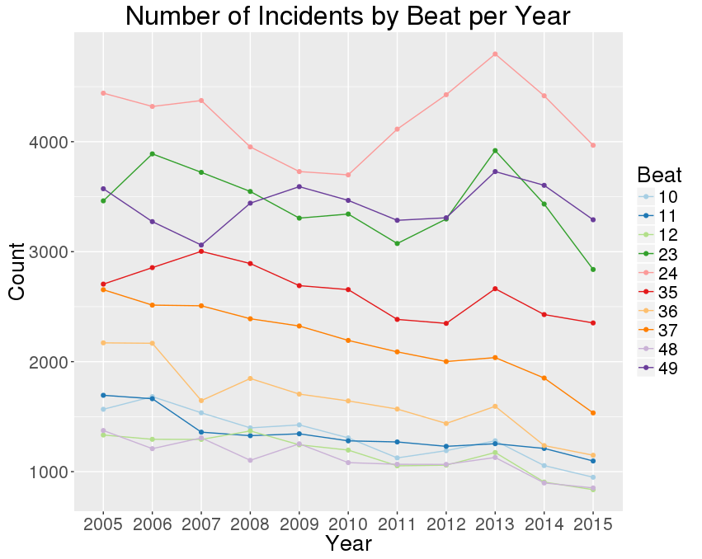
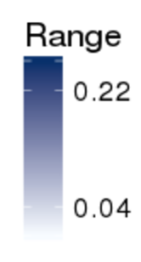
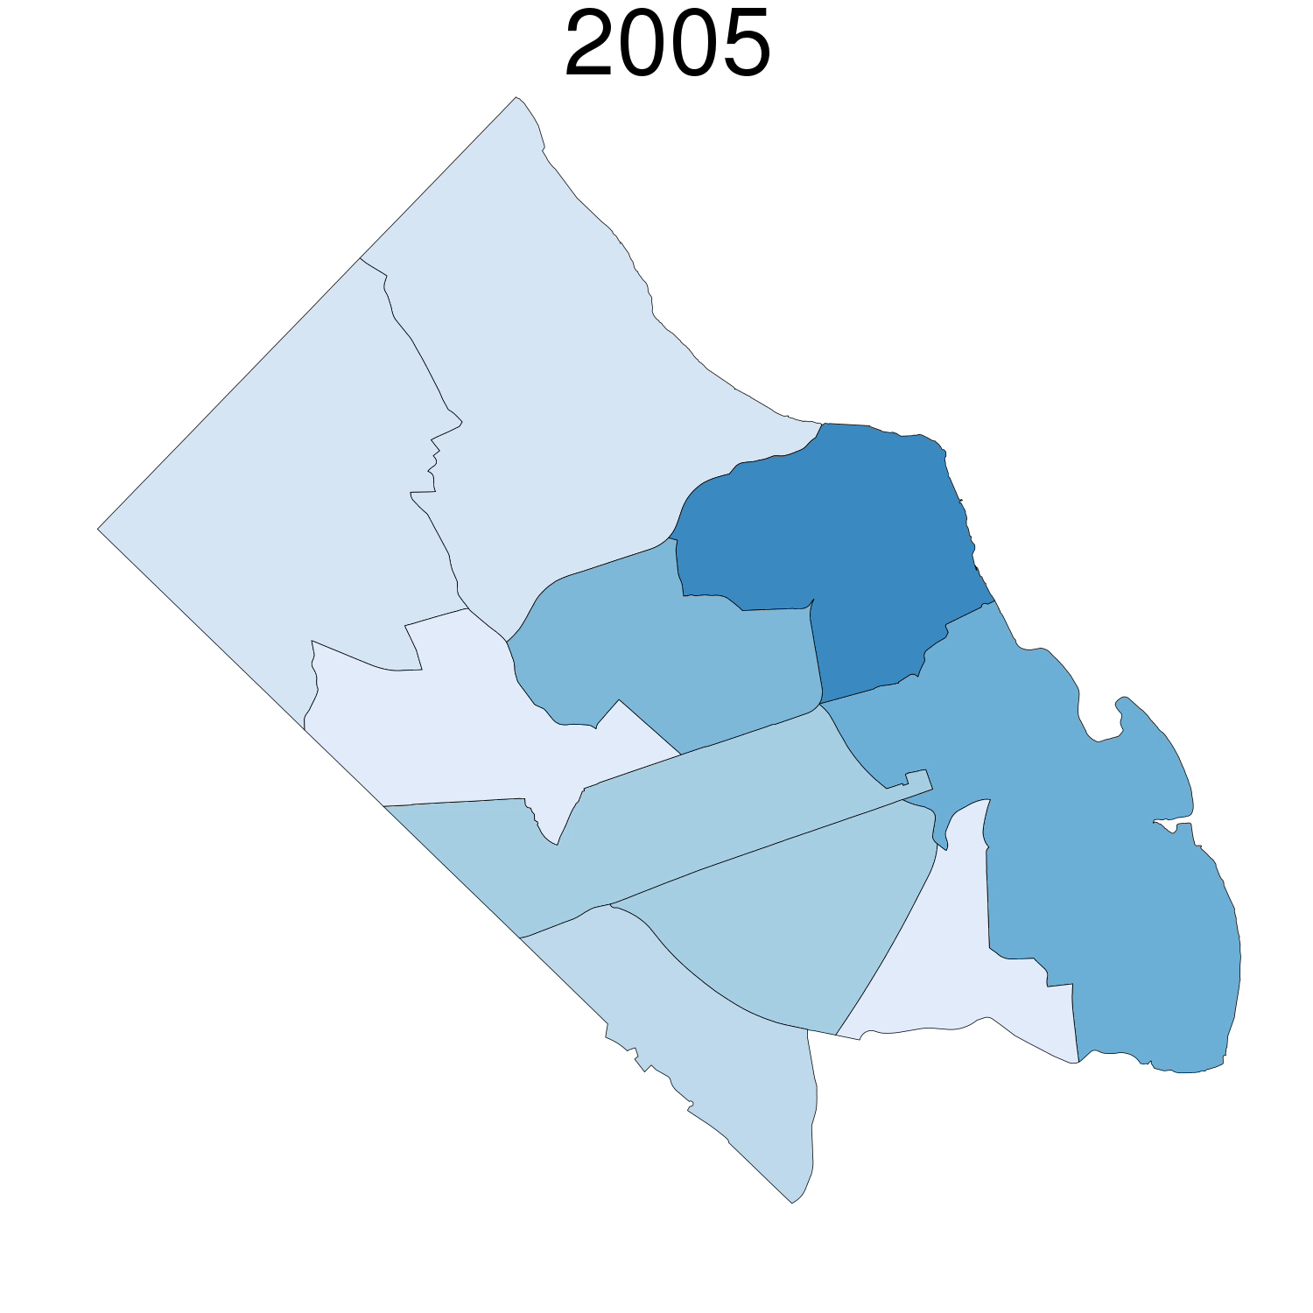
Incidents by Beat and by Year
Put beat numbers on map
Relative proportion of incidents per beat over years
11
10
24
23
12
35
49
37
48
36

Slide 31
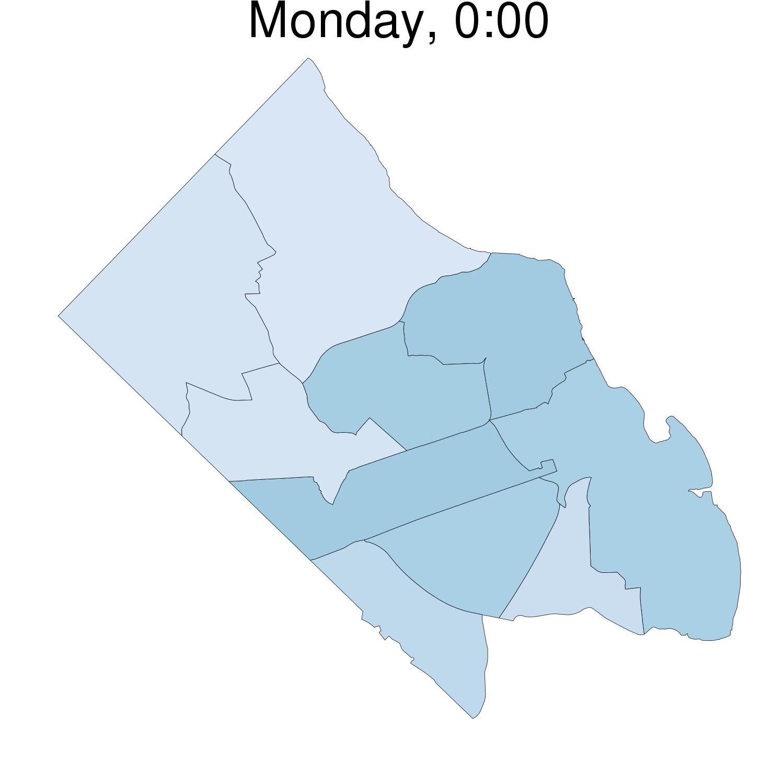
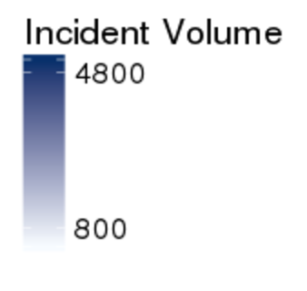
Rhythm of Arlington
Number of incidents by hour, and
by day of the week
2005-2015

Slide 32
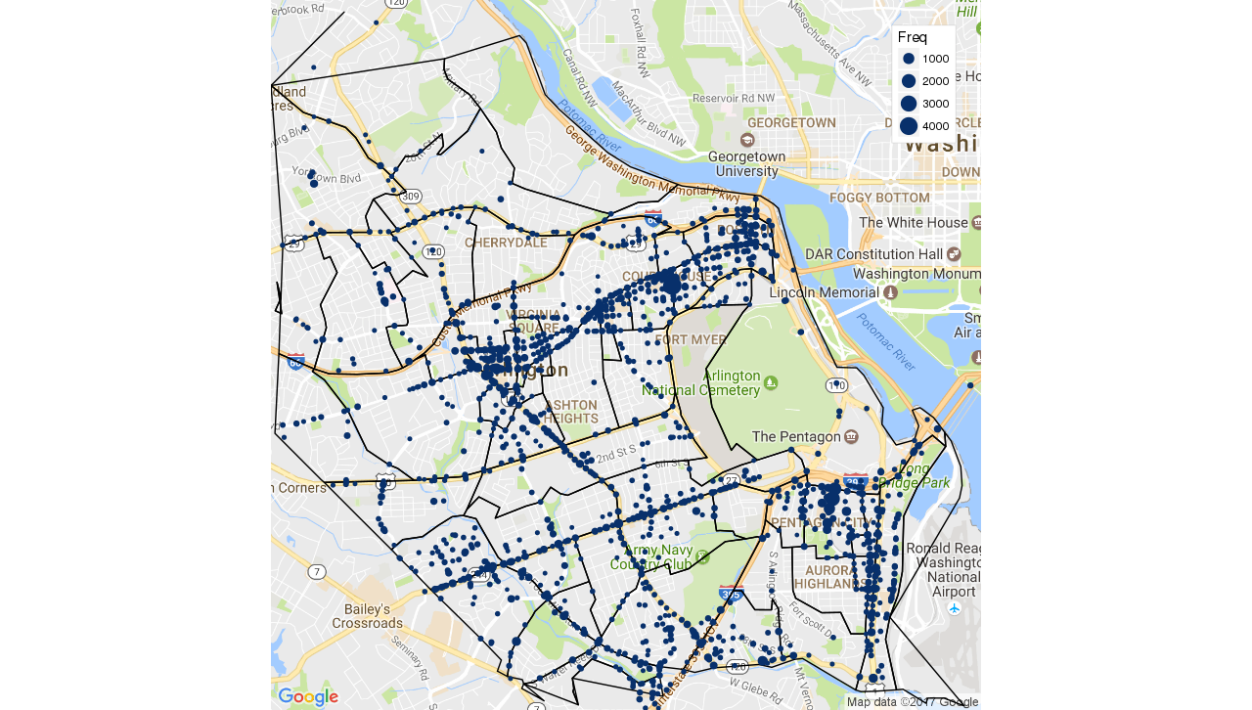
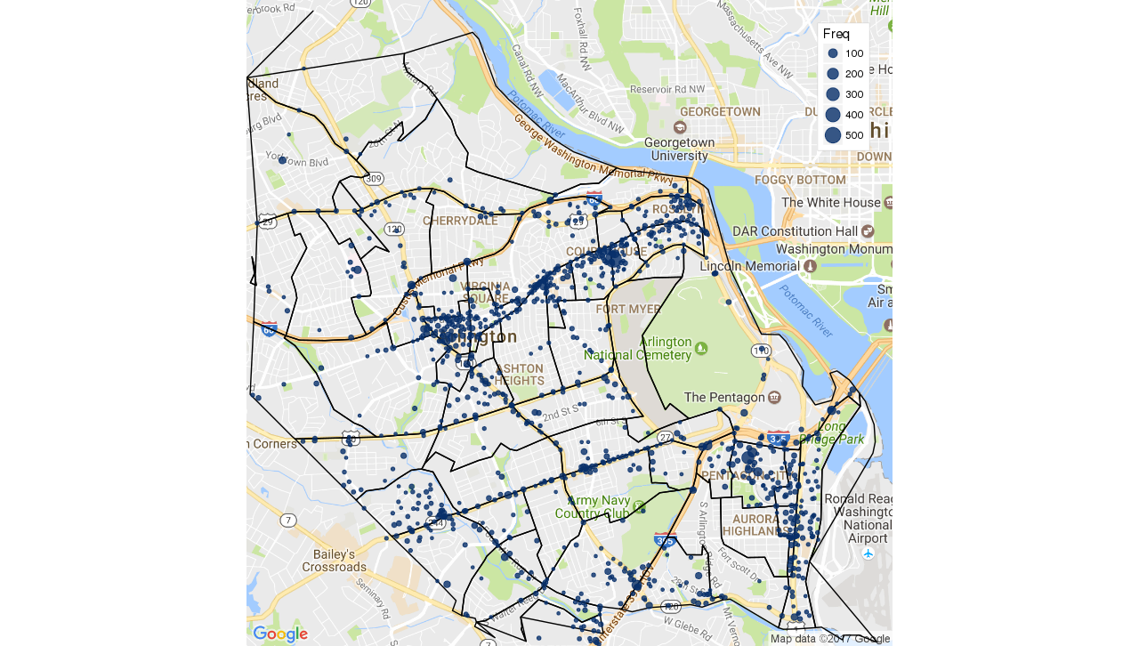
Hot Spots - Number of incidents by Lat-Long
2005-2015
2015
50% of all incidents are on 1059 locations (2015).
Courthouse area: Narcotics? and Found property
Pentagon city & Ballston Mall: Larceny (shoplifting), Trespassing, Embezzlement

Slide 33
Research Question:
AT-RISK YOUTH
Notes:
Thank organizers.
I am very excited to discuss a new initiative that we are developing and implementing at Virginia Tech to bring Data Driven Governance to our local governments and communities

Slide 34



Identifying Underserved Populations and At-Risk Youth
Three departments have issues that require a segment of the Arlington population to be identified.
Parks & Recreation: Who cannot afford their programs?
Library: Who are they not reaching and what are their needs?
Police: How to we reach at-risk youth before they get in trouble?
Notes:
Data Driven Governance is maturing in Arlington
3 departments are interested in overlapping issues
Conduct situational awareness as 1st step
who is NOT using their services
what are potential reasons?
what are neighborhood characteristics?
“Paint” picture of Arlington - demographics, transportation routes and options, schools, and other sources of data.

Slide 35
Identifying At-Risk Youth
How do we identify the at-risk youth in Arlington?
We can use your institutional knowledge.
We can conduct a literature search into the risk factors that have been identified.
Notes:
Data Driven Governance is maturing in Arlington
3 departments are interested in overlapping issues
Conduct situational awareness as 1st step
who is NOT using their services
what are potential reasons?
what are neighborhood characteristics?
“Paint” picture of Arlington - demographics, transportation routes and options, schools, and other sources of data.

Slide 36
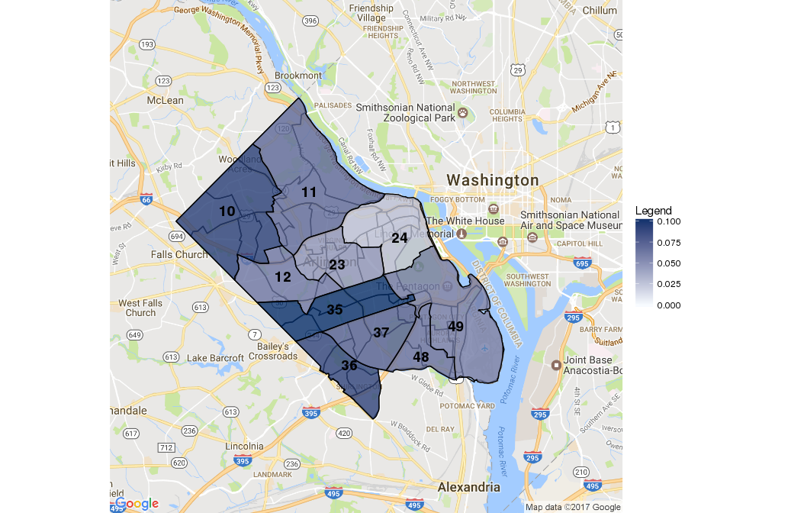
Proportion of Youth Incidents by Beat (2005 – 2015)
The data you have provided
let us know the prevalence and location of youth involvement with the police in the past.
Total Youth Crimes (2005-2015)/Total All Crimes (2005-2015)

Slide 37
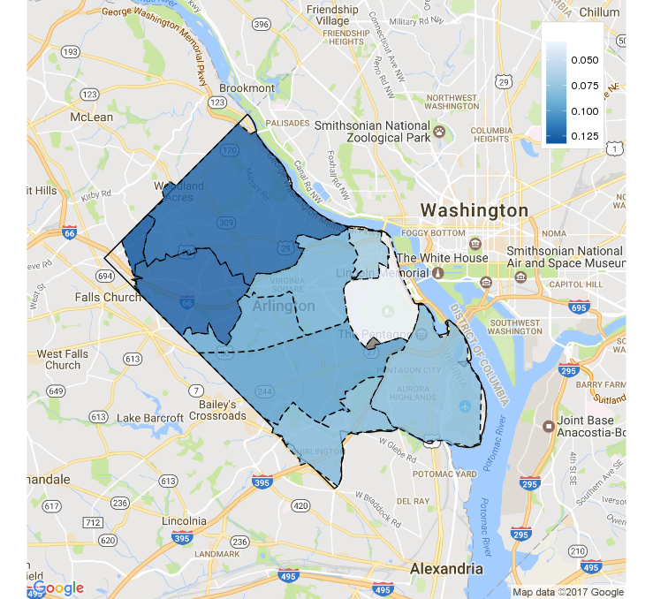
Proportion of Youth Incidents by Home Loc (Zip) (2005 – 2015)
22213
22207
22209
22205
22201
22203
22211
22204
22202
22206

Slide 38
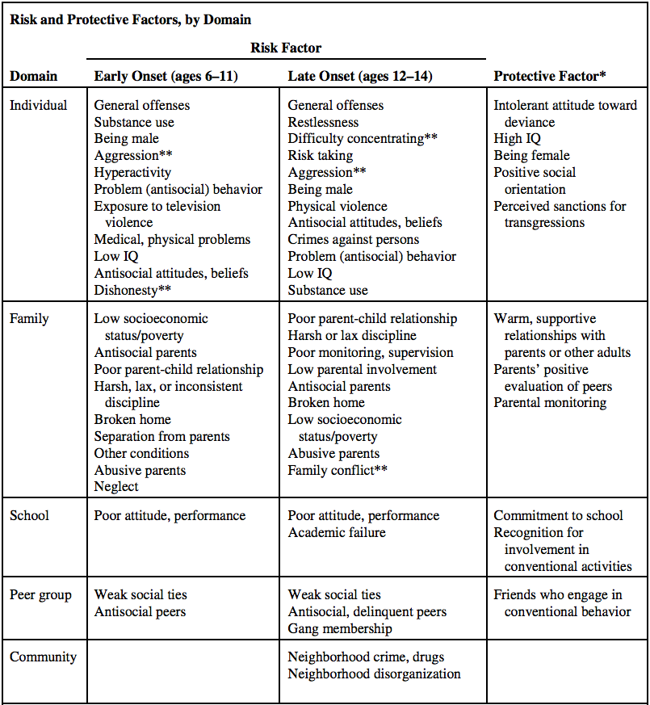
Risk Factors
Source: Shader, Michael. Risk factors for delinquency: An overview. US Department of Justice, Office of Justice Programs, Office of Juvenile Justice and Delinquency Prevention, 2001.

Slide 39
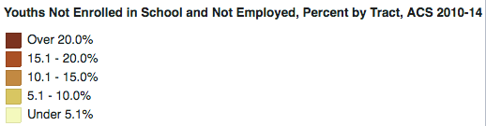
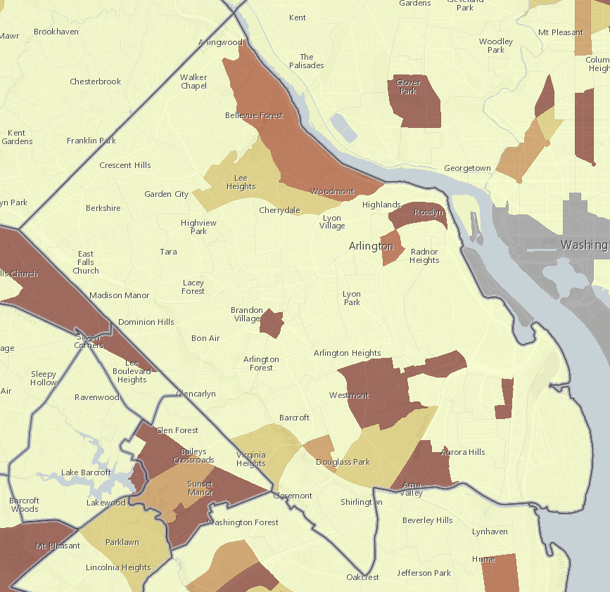

Slide 40
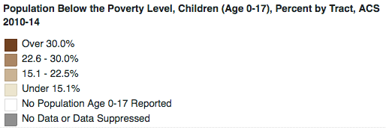
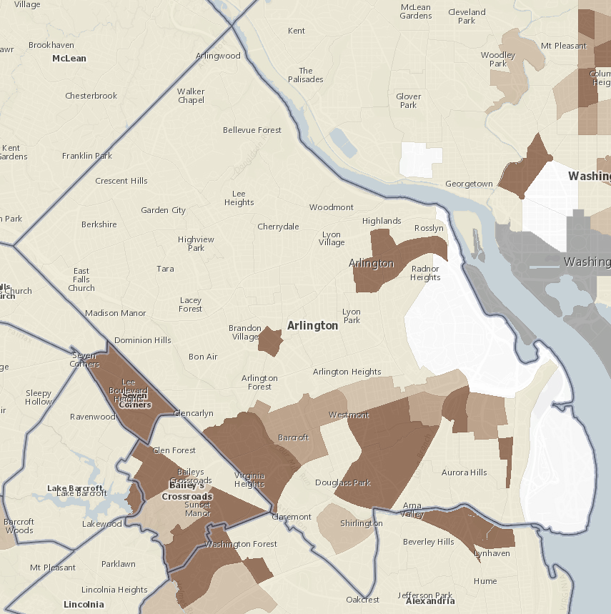
We can combine the Arlington risk factors information and construct a indicator for at-risk youth.

Slide 41
Discussion:
Identification of Issues
Notes:
Thank organizers.
I am very excited to discuss a new initiative that we are developing and implementing at Virginia Tech to bring Data Driven Governance to our local governments and communities

Slide 42
ISSUES
“We are not just lucky that the crimes are declining”
What is driving the decline even if population is increasing?
What is the impact of the actions/programs/campaigns established by law enforcement?
Impact on their management plans, amount of work may not be decreasing!
Potential data sources:
List of efforts (programs and initiatives over years) by ACPD
e.g., false alarm fines
Care-taking data from Clarendon (by Kamran)
ACPD social media accounts
External data sources: bar revenues, parking, ticket, transportation others?
Population change ACS?

Slide 43
ISSUES
“Robberies increase prior to holidays”
What to expect from specific events so that they can be better prepared?
Potential data sources:
List of events
e.g., snow events, Marine Corps marathon, snowzilla, inauguration, holidays, art festivals,.
March change
domestic violence & thanksgiving
full moon ☺

Slide 44
ISSUES
How will future development affect allocation of ACPD resources, and their needs?
planning number of officers needed and where, etc.
Revitalization projects increase needs
For example, plans are to redevelop the Ballston, Columbia Pike, Rosslyn, which is expected to lead to large surges in population.
Potential data sources?
EDA, demographers?
Population size, density, demographic change
overlaying other data to better understand crime patterns
Synthetic pop. Approach?

Slide 45
ISSUES
How do we identify the at-risk youth in Arlington?
Sources:
Institutional knowledge of ACPD
Risk factors that have been identified in the literature.
Overlay crime data onto a map of other variables
Education?

Slide 46
Risk Factors
Source: Shader, Michael. Risk factors for delinquency: An overview. US Department of Justice, Office of Justice Programs, Office of Juvenile Justice and Delinquency Prevention, 2001.

Slide 47
ISSUES
Houses in need of police?
Similar approach as in smoke alarm paper.
Potential data sources?
Crime
Real Estate Assessments
ACS variables
Fire/EMS

Slide 48
APPENDIX
Notes:
Thank organizers.
I am very excited to discuss a new initiative that we are developing and implementing at Virginia Tech to bring Data Driven Governance to our local governments and communities

Slide 49
Community Learning: Data Driven Discovery
Engage and expose local leaders to data driven learning
Work with local leaders to define critical questions and issues facing their community
Identify and wrangle the data sources
Use statistical and geospatial learning along with the communities’ collective knowledge to inform policy decisions
Develop, deploy, and evaluate intervention strategies and education programs based on experimental design principles
Continuous and adaptive data driven learning cycle
Notes:
Our goal is to scale this process and make it sustainable by deploying it thru the Land Grant University infrastructure of Cooperative Extension Services. LGUs translate research of all kinds to action are in every city and county across the United States.
Data Framework
We have developed a rigorous, yet flexible, process for building local sustainable community learning cultures
Expose local leaders to data driven learning through a dialogue process of meetings and forum across government departments and offices. A single department may be reticent to tackle an issue, e.g., vulnerable populations. These used to identify issues and data sources that span their boundaries.
Work with local leaders to define critical questions and issues facing their community by asking them “what keeps them up at night?”
Wrangle the data sources that cut across programs to understand its quality and how to use it in our analyses.
Use statistical and geospatial learning along with the communities’ collective knowledge to develop hypothesis to inform policy decisions relevant to issues identified.
Develop and deploy intervention strategies and education programs to address issues. Evaluate hypotheses using experimental design principles. Adapt strategies based on continuous evaluation.
Creating a scalable and sustainable CL system: Leverage Land Grant University (LGU) Cooperative Extension Service (CES) infrastructure that has agents in every city and county. Adapt CES outreach model to include direct engagement with local government leaders.

Slide 50

Data science partnerships with communities to liberate their data
Breaking down silos across programs and agencies
Addressing concerns of community leaders through all data and statistical learning
Through liberating and repurposing local data flows, local govt leaders and researchers contribute to the public good
Notes:
We have developed a rigorous, yet flexible, process for building local sustainable community learning cultures
Expose local leaders to data driven learning through a dialogue process of meetings and forum across government departments and offices. A single department may be reticent to tackle an issue, e.g., vulnerable populations. These used to identify issues and data sources that span their boundaries.
Work with local leaders to define critical questions and issues facing their community by asking them “what keeps them up at night?” and then liberating and repurposing their data to address these questions.

Slide 51

Our research has begun and includes…
Creation of a secure collaborative research environment to access and link data …..
Development of statistical and geospatial indicators ….
Development of experimental designs for policy interventions and evaluations
Notes:
Our research has begun
Creation of a secure collaborative research environment to access and link data from the federal, state, and local levels together with other data sources for the community and researchers
Development of a disciplined framework to wrangle the data sources that cut across programs to understand its quality and how to use it in our analyses.
Working with our local govt leaders to identify and address their questions and then to develop statistical and geospatial indicators
Develop and deploy intervention strategies and education programs to address issues. Evaluate hypotheses using experimental design principles. Adapt strategies based on continuous evaluation.

Slide 52
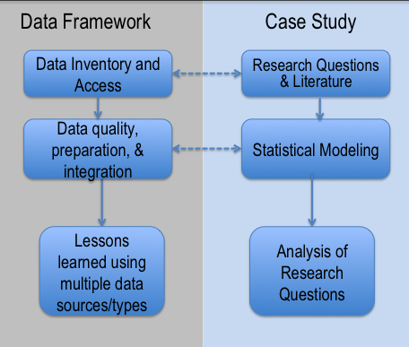
Research Model

Slide 53
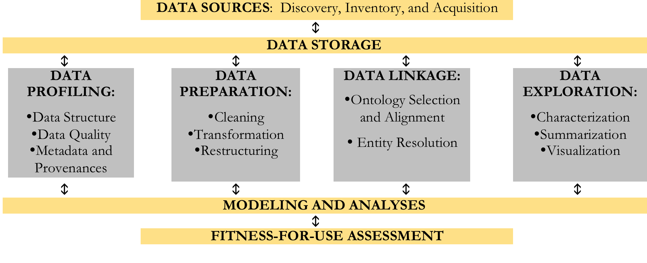
SDAL Data Framework

Slide 54
Profiling: Data Structure
Repurposing requires restructuring for analysis
Missing variable names
Combined variables: more than one variable represented in a column
Multiple observations direction: columns and rows have variable names
Combine observational unit type: multiple types of data per record
Divided observation unit type: splitting an observational unit type among multiple data sources

Slide 55
Data Tables
Notes:
TABLES:
7 tables, some of the important variables in each
Combine them by Call_No and Report_No variables
Both CFS have Call_No
CFS20052015 has Report_No
All inmast tables have Report_No
Original_Call has 222 codes while Call has 438, so Call is much more detailed
PROFILING:
Most important are hyperlinked to the profile we generated for each variable
Show 'Call' page
Definition from codebook autopopulates
Valid values dropdown
Data Analytics Summary (completeness, uniqueness, validity)
Report also contains all of the code used to calculate percentages
Show distribution at the very bottom
First graphic can be customized to be most informative (labeled call codes, limited to most frequent 20 codes)

Slide 56
Data Tables

Slide 57
Top Calls (w/ Rep) across Years
 | Original Call Type | Number of calls (2005-2015) | Number of calls (2005) | Number of calls (2010) | Number of calls (2015)
10 | T – Traffic Stop | 57242 | 3591 | 5856 | 4777
5 | LARC - Larceny | 20478 | 2627 | 1768 | 1164
7 | PDO - | 15175 | 1594 | 1165 | 1377
6 | PARK | 11074 | 1188 | 772 | 842
1 | AWI | 7107 | 647 | 646 | 500
2 | BOOT | 7039 | 719 | 772 | 161
4 | FRAUD | 5729 | 811 | 347 | 392
9 | SUSP | 5699 | 809 | 425 | 335
8 | SS | 5497 | 172 | 508 | 537
3 | DOME | 5282 | 486 | 544 | 486
 | Total Calls

Slide 58
Top Call Types across Years
2005-2015
2005
2015

Slide 59
Incident Type | Number of incidents (2005-2015) | Number of incidents (2015)
98xx – Suspicious person-auto/Warrant/False alarms/Misc. Officer/Domestics | 65,388 | 5,578
9899 – Misc. Officer 981x – Susp. Person/auto 9800 – Warrant | 52,054 6,171 2,084 | 4,610 448 249
23xx – Larceny | 30,587 | 2,001
94xx – Motor vehicle accident | 29,751 | 2,550
92xx – Parking violation | 19,399 | 1,137
13xx – Assault | 11,551 | 950
29xx – Vandalism | 10,016 | 438
41xx – Drunk/Liquor/Detox/ABC | 9,448 | 696
97xx – Suicide/attempted suicide/find body/sick/mental | 7,704 | 893
35xx – Narcotics | 7,520 | 867
93xx – Lost person/property/animal | 6,687 | 551
99xx – Public assistance (traffic, lights, wires) /Misc. public | 6,139 | 249
Total for top incidents | 204,190 | 15,910
Total incidents | 250,268 | 19,307

Slide 60
Top Incidents across Years
Incident Type | Number of incidents (2005-2015) | Number of incidents (2015)
53xx – Disturbing peace (anarchism, riot, fire alarm, etc.) | 5,949 | 482
57xx – Violation of privacy (Trespassing) | 5,166 | 464
54xx – Driving under influence | 5,462 | 348

Slide 61
Understanding Underserved Populations and At-Risk Youth
Data Driven Governance is maturing in Arlington
3 departments have overlapping issues
Conduct situational awareness as 1st step
who is NOT using their services
what are potential reasons?
what are neighborhood characteristics?
“Paint” picture of Arlington using many data sources
Notes:
Data Driven Governance is maturing in Arlington
3 departments are interested in overlapping issues
Conduct situational awareness as 1st step
who is NOT using their services
what are potential reasons?
what are neighborhood characteristics?
“Paint” picture of Arlington - demographics, transportation routes and options, schools, and other sources of data.

Slide 62
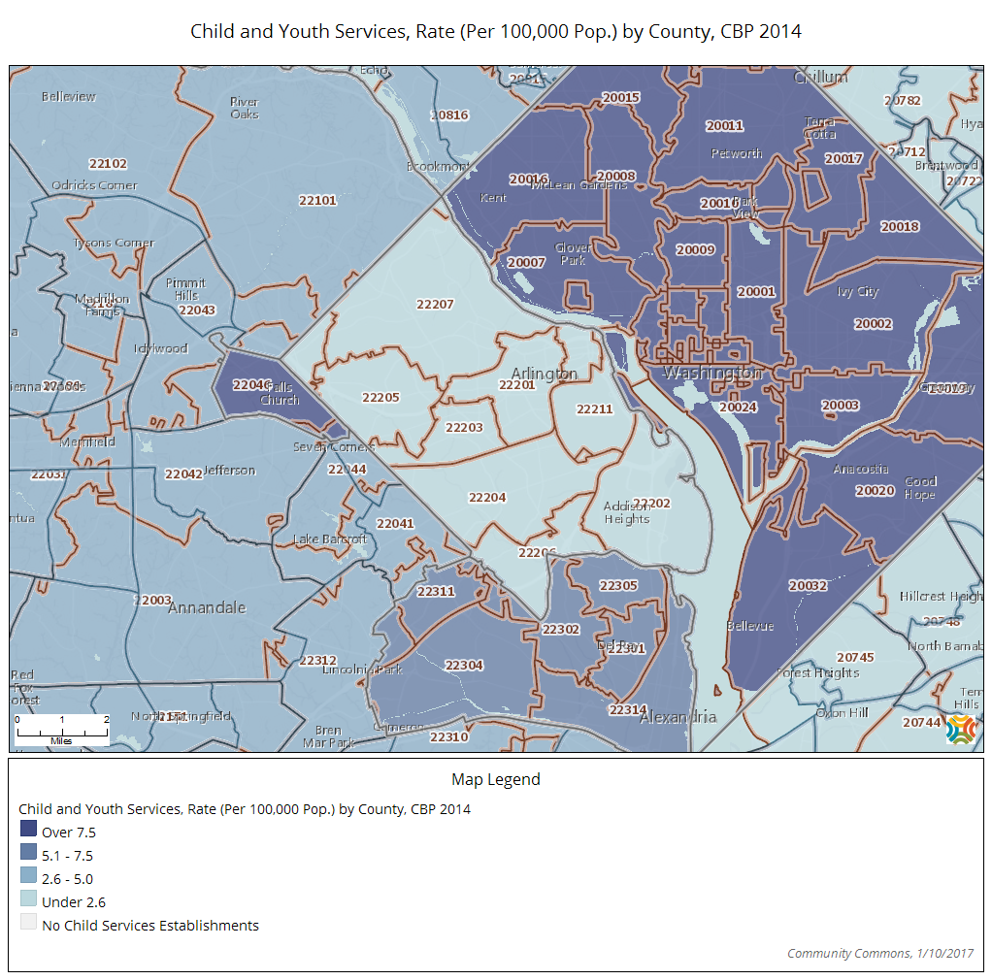

Slide 63
Youth Incidents by Beat

Slide 64
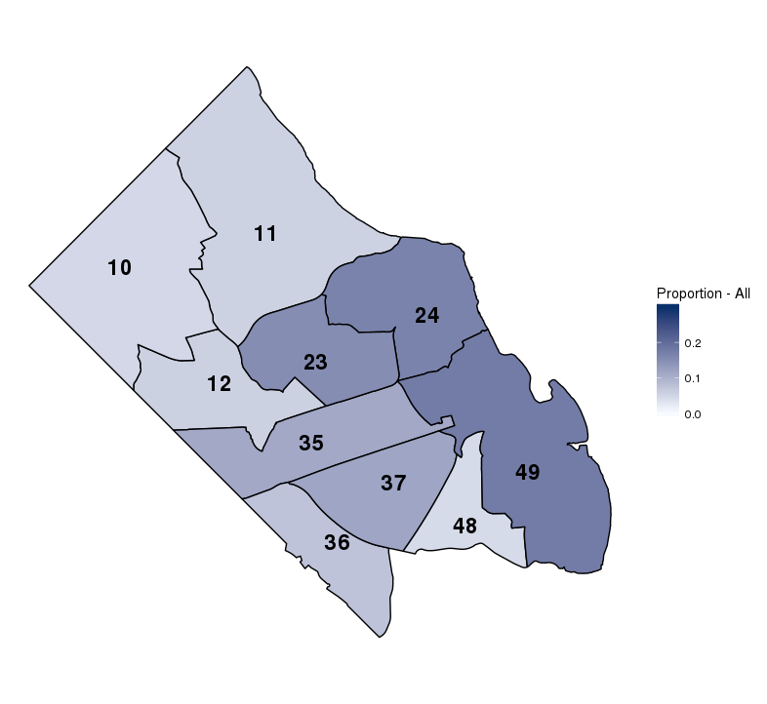
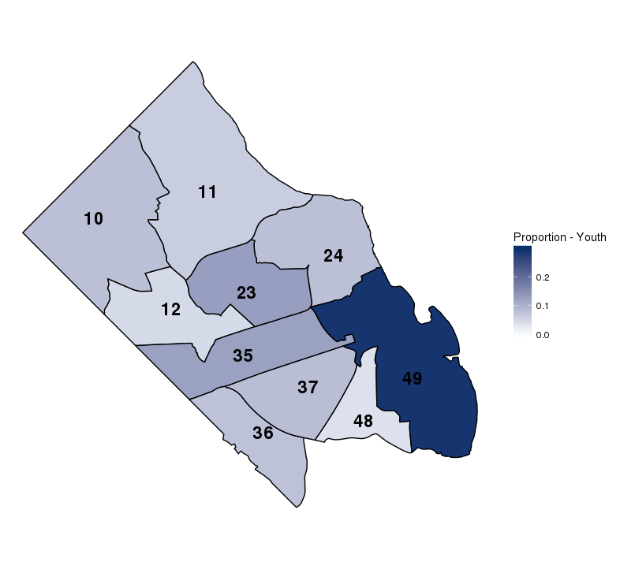
Incident rates by Beat
Proportion of all crime
Proportion of youth crime

Slide 65
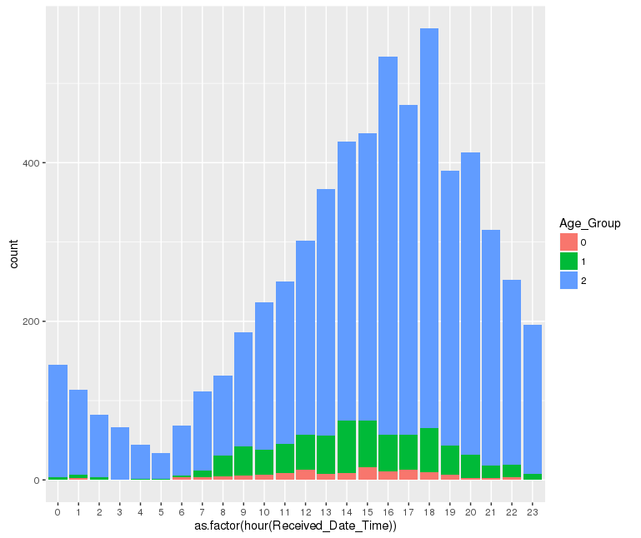
Youth throughout the day
Notes:
Middle school crime peaks from 2-3pm
High school crime peaks at 4pm and 6pm
Probably related to school dismissal time

Slide 66
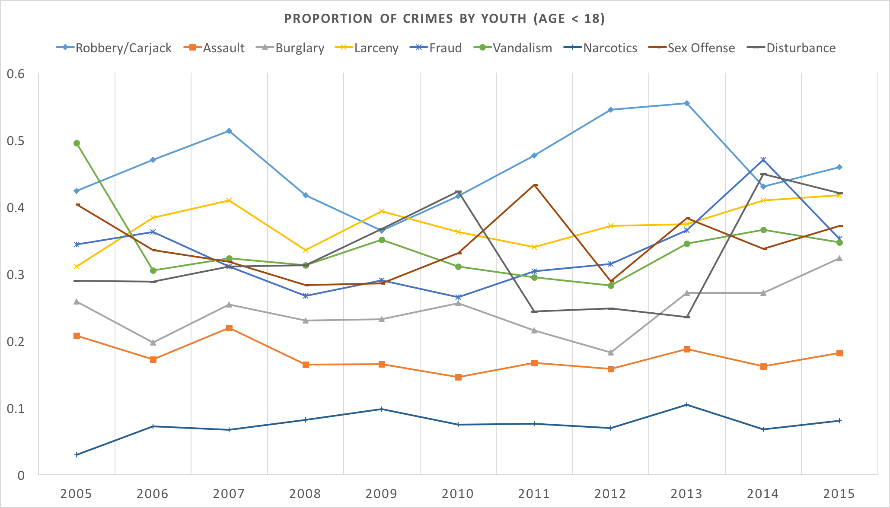

Slide 67
Risk Factors
Source: Shader, Michael. Risk factors for delinquency: An overview. US Department of Justice, Office of Justice Programs, Office of Juvenile Justice and Delinquency Prevention, 2001.

Slide 70
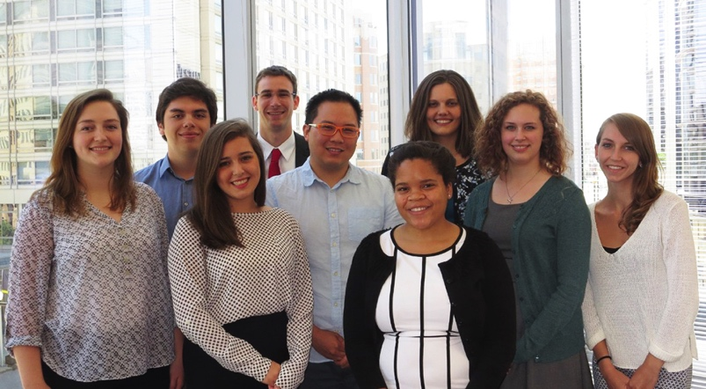
Partnership with Arlington County - A demonstration
Improve quality of life and services while accelerating county’s efficiency and resiliency
Develop situational awareness
Notes:
Before I tell you about our ambitious vision, let me first tell you how our vision came to be.
We have a deep partnership working with local civil servants in Arlington County.
Arlington local government leaders would like to have a better understanding of their data flows to improve situational awareness as well as the quality of life in Arlington.
The picture on the left is of our students who participated this past summer in a Data Science for the Public Good program – describe – preparing the next generation data scientists to work in and with local govt. We want to engage them in early hands on experiences. They work on vertically integrated teams ranging from students to senior researchers on a variety of cross-disciplinary issues.
.
We are also part of Metrolab, which is a group of cities who share best practices.

Slide 71
Data silos: taxonomy of 911 incidents
Fire
and
EMS Data
Notes:
First example goes like this – The Fire Chief asked if it was it possible to link together all of the data during the course of an emergency to recreate the incidents. This sounds simple, but it is not.
The data being collected are used to guide the Fire/EMS staff through their work. What you see in this picture is that there are 4 to 5 systems in which data are collected.

Slide 72
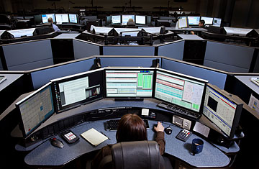

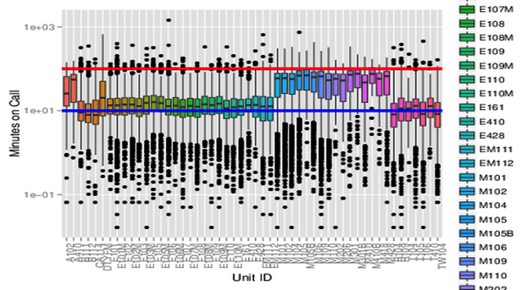
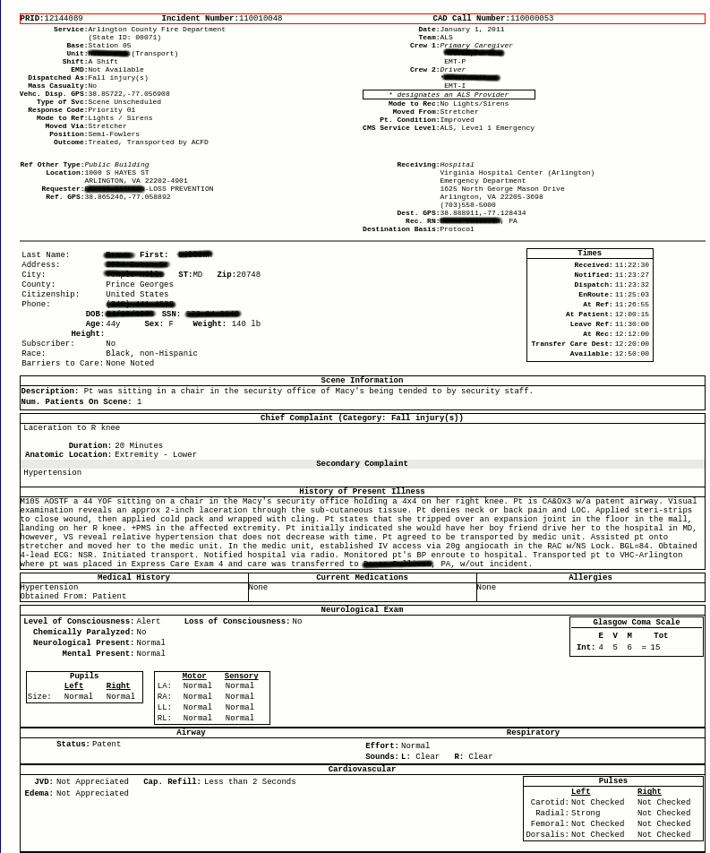

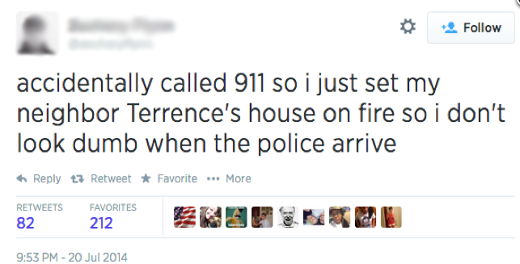
Notes:
Calls come into the CAD center.
Units are deployed and data collection about response times and other information begins to accumulate.
Personnel on each medic and engine unit are responsible for recording information and completing after-action reports.
At the same time, social media is occurring.
There is no magic identifier to neatly link these data. The systems are not designed to do this.

Slide 73


Unit Utilization
Linking Incident Linked Across Time
Minutes on Call
Notes:
Fire Chief said they are always out of medic units
First mapped the data out for every day over a three year period. The map on the LHS shows when a engine unit the gold lines) and medic units (the blue lines) are out.
Then we mapped the data to show their utilization by hour of day to see when there are peaks in usage.
Then, looking at the RHS, we computed some descriptive statistics
Fire Chief was better able to allocate his medic units but could also use the data to obtain more resources.

Slide 74


Loyal Customers or Loyal Locations
Mash up data with geography
Identifies hotspots
Deeper look into data and find these align with populations at risk in community
Notes:
Another way to portray the data is by geography. In this example, we mapped the 911 incidents by time of data and day of week.
Rhythm of the city - What struck us about this was how useful this representation of the data are for tracking flows of people throughout the workday and weekends.
Another is thru identifying hotspots such as identifying loyal customers.
Nurse Practitioner

Slide 75



Characterizing our Neighborhoods
Median House Value
Owner Occupied Units
ACS 2009-2013 Estimate
Tax Assessment Values
2013 AC Real Estate Data
Scale
Notes:
Characterizing our Neighborhoods through the use of open data
We often see local problems being described with federal data at a aggregate scale that ignores the heterogeneity in the smaller geographic scales
Using ACS data masks the heterogeneity of housing and wealth in Arlington.
Using local property data provides more detailed

Slide 76




Simpson Index of Home Value Diversity
Census Tract
Census
Block Group
Source: Arlington County Real Estate Assessment 2013
Notes:
Simpson Index of Home Value Diversity
By using local property data the value of the home can be used as a proxy for wealth.
Arlington demographers found the mapping of home values as an index very informative for assessing the availability of a variety of housing opportunities for families.

